Slide 1
Washing machine
By:Freddie Boadu

Slide 2
Project overview
Make a washing machine with 4 different activities- rinse soak wash spin
Make 2 modes for the washing machine
Make sure the lid will close and if it doesn’t have a timer for it
Have a timer for the washing machine to switch states

Slide 3
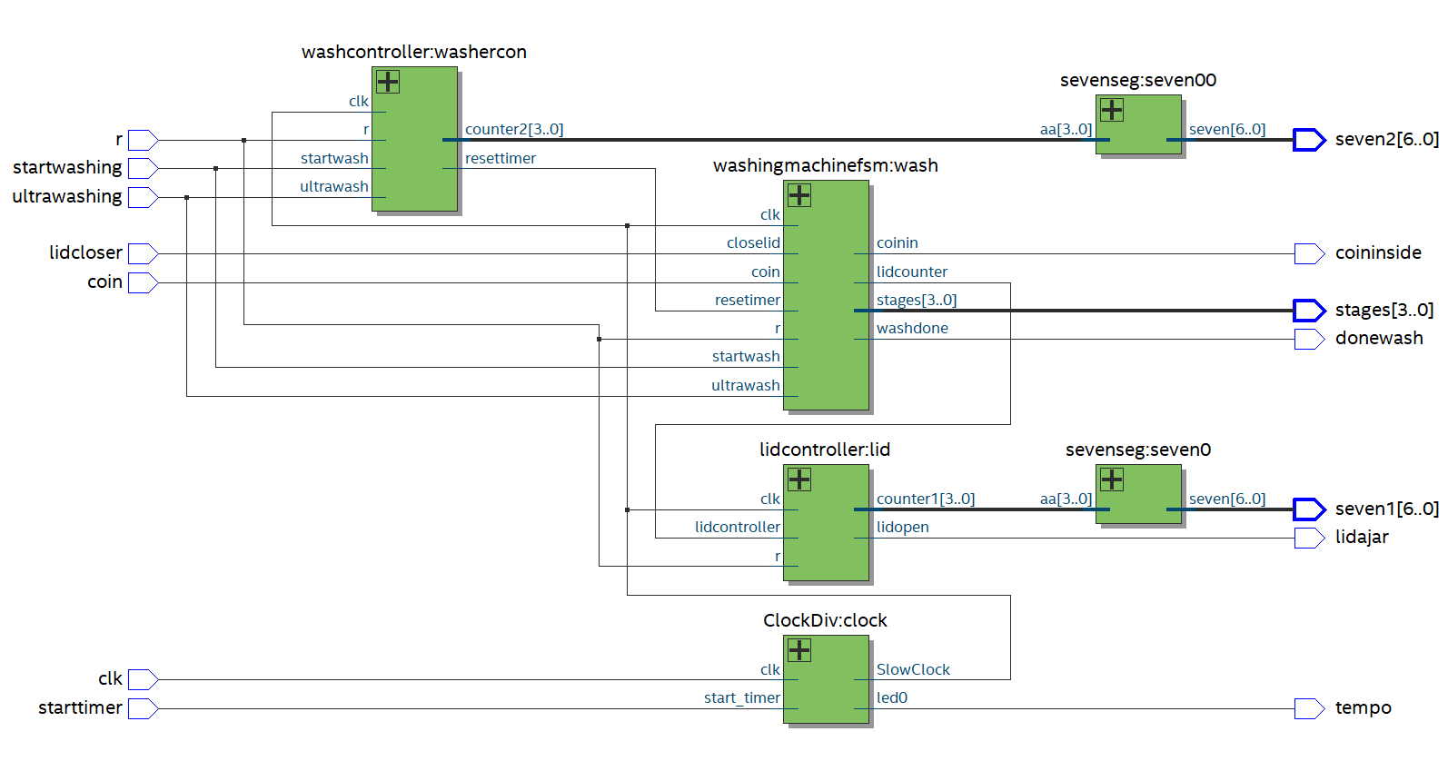
Block diagram

Slide 4
State machine
!Time good
soak
waiting
coin
!Time good
Time good
wash
!Time good
!Time good
Time good
Washer reset
wash2
rinse
Time good
Time good
!Time good
!Time good
Time good
rinse2
spin
Time good
Wash done
Lid-open
!Wash done

Slide 5
Pitfalls and achievements
Best Pitfall: don’t mess with things if they are working
Achievement: Learned how an washing machine would work on a fpga
Achievement: learned the importance of being ok with your design

